Slide 1



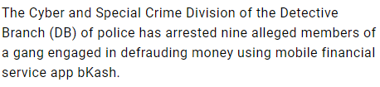

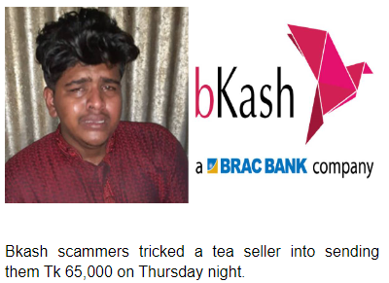

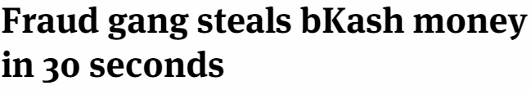

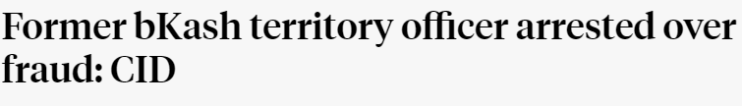
Online and Mobile Financial Services: Regulations and Criticisms
Name: | ID:
Lamyea Tasneem Maha | 2019-1-60-055
Rafid Mahmud Haque | 2019-1-60-085
Noor Fabi Shah Safa | 2019-1-60-060
Introduction to MFS
Terms of Service (ToS), End-User License Agreement (EULA), and Privacy Policy
Criticism of MFS Companies
MFS stands for Mobile Financial Services
Offers financial services like monetary transactions through wireless network
Some of the leading MFS providers include :
Not a single company uses a secondary authentication factor.
Data access option only given in Nagad, but charges are applicable
No Opt-Out option available in any company
No extra protection option given for sensitive data.
bKash, Nagad, and Upay:
ToS
Privacy Policy
EULA information
Yes
Yes
Service Name | Bank/Service Provider
bKash | Brac Bank Ltd. Bangladesh
Nagad | Bangladesh Post Office
Upay | UCB Fintech Company Limited
Rocket | Dutch Bangla Bank Ltd. Bangladesh
Sure Cash | Bangladesh Commerce Bank Ltd. Bangladesh
Not explicitly mentioned
Analyzing the Terms of Service, Privacy Policy
1. Information collected and how is it used | Personal information: Full name Shop, Business, or Institute name Contact information etc. How the information is used: For business purposes like quality control and marketing For fraud prevention, detection, and prosecution. | Personal information: Name Phone number NID information How the information is used: For ensuring better service Track transaction history | Personal information collected like: Full name Shop, Business, or Institute name Contact information etc. How the information is used: For fraud prevention, detection, and prosecution Monitoring users communications For business purposes like marketing, quality control and training
2. Does this service Inform users before collecting data? | Yes | Yes | Yes
3. How to opt out? | No information given | No information given | No information given
4. Is stronger protection provided for sensitive data? | No information given | No information given | No information given
5. How long the data will be kept for | No information given | As long as re required | No information given
6. Maintaining accuracy and security of collected data | No warranty or guarantee related to the security measures of the personal information | Highest security is ensured but will not be responsible for security breach | Implement a variety of security measures to maintain safety. No warranty or guarantee from third parties or from site
7. How to access and correct the stored data? | No information given | Can access the data but will be charged for that, | No information given
Scams
Regulations/Guidelines regarding MFS in Bangladesh
From oldest to the most recent:
Regulatory Guidelines for Mobile Financial Services (MFS) in Bangladesh (Revised version, July 2015)
Bangladesh Mobile Financial Services (MFS) Regulations, 2018
Bangladesh Mobile Financial Services (MFS) Regulations, 2022
All MFS providers must ensure :
Confidentiality
Integrity
Authorization
Non-repudiation
A mandatory requirement:
Ensure authentication by account holders using secure way such as PINs.
A practice encouraged:
- Second authentication factor
Scam by frauds:
MFS companies are failing to secure service against frauds
Frauds pretends to be officials of the company and get the PIN
Then they transfer the money
Even social engineering frauds also happening in MFS
Conclusion
Regulation’s Criticisms?
Experts suggestions:
Experts suggest to integrate fingerprint option in MFS
If big transaction is needed, then fingerprint required.
Digital security act 2018 not mentioned
Follows ICT Act 2006

